Slide 1

COIS 3320: Fundamentals of Operating Systems
Alaadin Addas
Week 9
Virtual Memory

Slide 2
Overview
Announcements/Reminders
Recap
Principles of Virtual Memory
Page Replacement Algorithms
Summary

Slide 3
Announcements/Reminders
Assignment 3 will be released on Monday and will be due two weeks after it is released.
The date is slightly pushed back from the date stated on the syllabus.
Lab 3 is due by tonight, make sure you submit it!
Your report proposal is also due by tonight, make sure you submit it!

Slide 4
Recap
What is the difference between the physical and logical address space?
How does the first fit memory allocation algorithm work?
How does the worst fit memory allocation algorithm work?
What are some advantages/disadvantages of the worst fit memory allocation algorithm?
How does the best fit memory allocation work?
How does the next fit memory allocation algorithm work?

Slide 5
Virtual Memory
Before we dig into the principles of virtual memory, I would like to take some time to review a basic concept from Computer Organization.
The memory hierarchy!

Slide 6
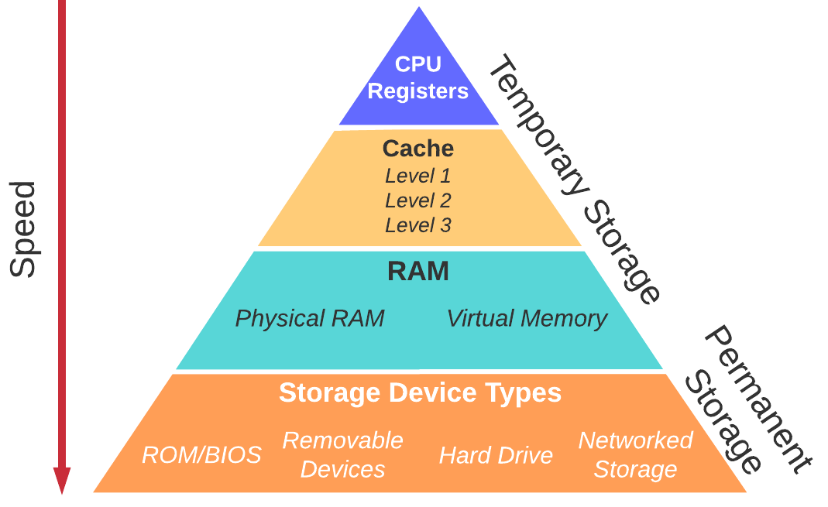
Memory Hierarchy

Slide 7
Principles of Virtual Memory
Virtual memory (VM) is a collection of one or more logical address spaces, each of which may exceed the size of physical memory.
A logical address is then referred to as a virtual address.
A paged VM creates a single large contiguous address space per process.
A paged VM with segmentation creates multiple large address spaces per process, each of which is paged.
Demand paging is the principle of loading a page into memory only when the page is needed, rather than at the start of the execution.
A present bit is a binary flag in each page table entry that indicates whether the corresponding page is currently resident in memory.
If a page is resident, then the entry points to the frame that holds the page.
A page fault is an interrupt that occurs when a program attempts to reference a non-resident page.
The interrupt triggers the operating system to find the page on disk, copy the page into a frame, and set the present bit to 1.

Slide 8
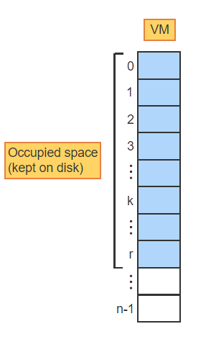
Demand Paging – Visualization – 1
A VM is a large address space consisting of pages [0:n-1]. The portion occupied by the program (pages [0:r]) is kept on disk. The remaining pages are just an abstraction

Slide 9
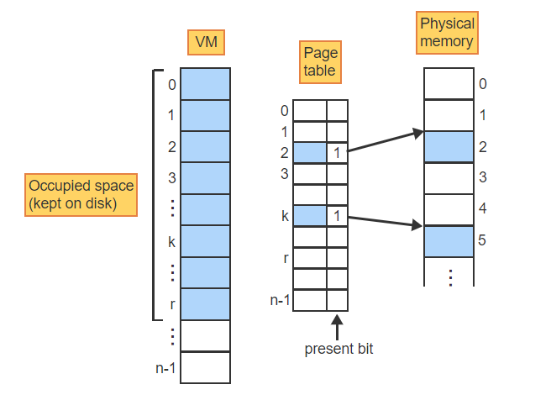
Demand Paging – Visualization – 2
A page table keeps track of which pages are currently in physical memory. If a page is resident, then the present bit is set and the entry field points to the corresponding frame

Slide 10
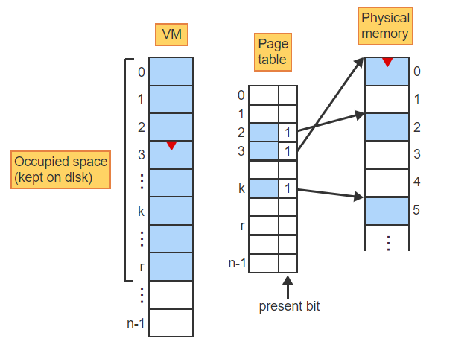
Demand Paging – Visualization – 3
If execution crosses a page boundary into a non-resident page, the present bit triggers a page fault, which causes the page to be copied into a free frame. The page table is updated

Slide 11
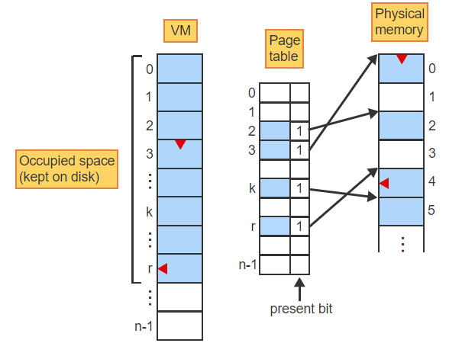
Demand Paging – Visualization – 4
Similarly, when execution references a non-resident data page, a page fault causes the page to be copied into memory and the page table to be updated accordingly

Slide 12
Page Replacement
Virtual memory is typically much larger than the available physical memory.
When all frames are occupied and a page fault occurs, one of the resident pages must be removed from memory to create a free frame.
Page replacement is the act of overwriting a page in memory with a different page loaded from the disk when needed.
Moving pages between memory and the disk is very time consuming and must be minimized (remember that memory hierarchy).
When the page to be removed has not been modified during execution then an exact copy still exists on the disk and the page does not have be copied back to the disk.

Slide 13
Page Replacement – Modified Bit
A modified-bit (m-bit) is a binary flag in each page table entry that indicates whether the corresponding page has been modified during execution.
The modified bit is set to 1 automatically by any instruction that stores data into the page and is used by the operating system to minimize the movement of data to disk.

Slide 14
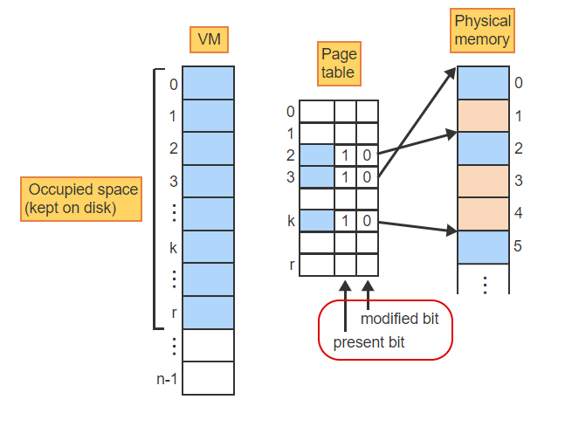
Page Replacement – Visualization – 1
The page table uses the present bit to keep track of which pages are in physical memory, and the modified bit to keep track of which pages have been modified

Slide 15
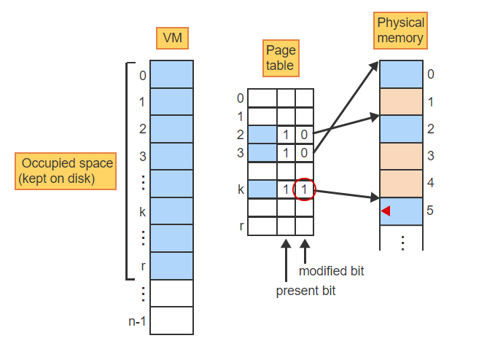
Page Replacement – Visualization – 2
As the program executes, some of the memory-resident pages become modified, making the copy on disk obsolete (page k). The modified bit is set to 1

Slide 16
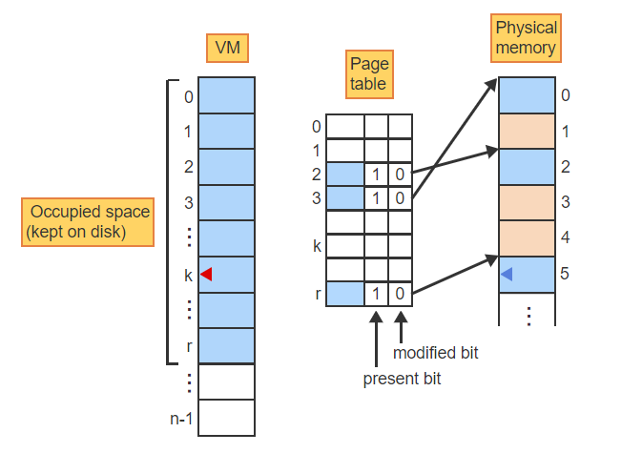
Page Replacement – Visualization – 3
When a page fault decides to replace page k in frame 5 with page r then page k must first be written back to disk before being overwritten by page r

Slide 17
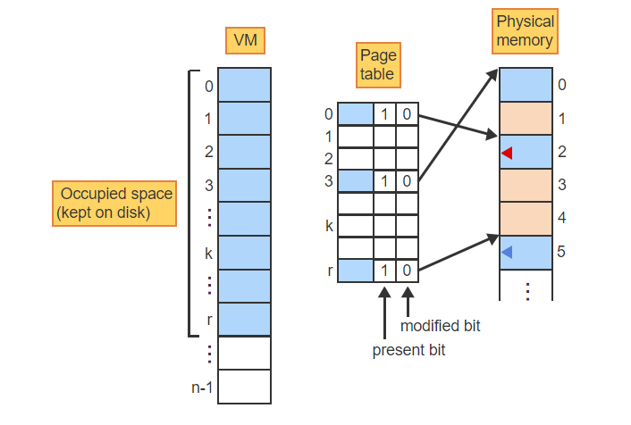
Page Replacement – Visualization – 4
When a page fault decides to replace page 2 with page 0 in frame 2 then page 2 can be overwritten without saving because an exact copy is still on disk

Slide 18
P & M Bits Exercise 1
p = 0 means the page is currently not resident in memory.
p = 1 means the page is currently resident in memory.
m = 0 means the page has not been modified.
m = 1 means the page has been modified.

Slide 19
P & M Bits Exercise –2
A page must be written back to disk when p=? and m=?
Immediately after a page replacement p=? and m=?
A page fault is triggered when p=? and m=?

Slide 20
Paging of Tables
Virtual memory can create address spaces much larger than the available physical memory.
For example, a 64-bit virtual address, the potential size of VM is 2^64
Of course, some of that potential size will be taken by the offset and the segment.
Since few programs make use of such large address spaces, much of the space taken up by a table in memory would be wasted.
To reduce the overhead, a table can be divided into individual pages and brought into memory as needed using demand paging and page replacement.
A segment table can be divided into pages by dividing the segment number s into two components, s1 and s2, and to use a new page table to keep track of the pages constituting the segment table.
Similarly, a large page table can be divided into pages and kept track of by another higher-order page table.

Slide 21
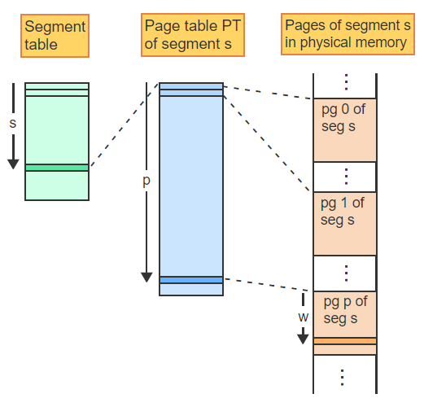
Paged Page Table Address Translation – 1
A 3 level hierarchy starts with a segment table. The entry s points to the page table of segment s and each entry of the page table points to one page of segment s in physical memory

Slide 22
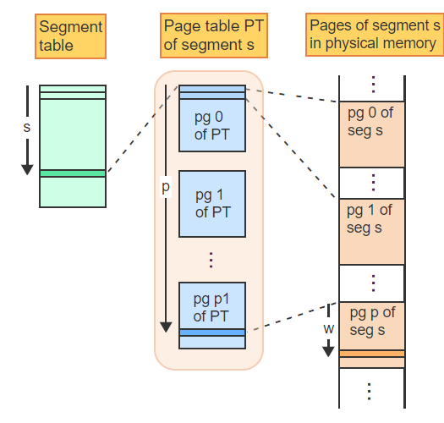
Paged Page Table Address Translation – 2
A page table that is too large to keep in memory may be subdivided into pages, each entry still pointing to the same pages as before

Slide 23
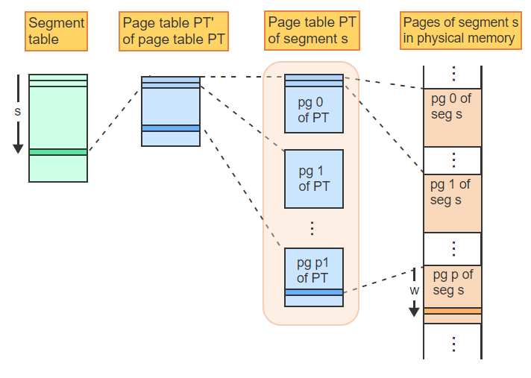
Paged Page Table Address Translation – 3
To keep track of the pages constituting the page table, a higher order page table PT' of the page table PT is introduced. Each entry points to a page of the page table

Slide 24
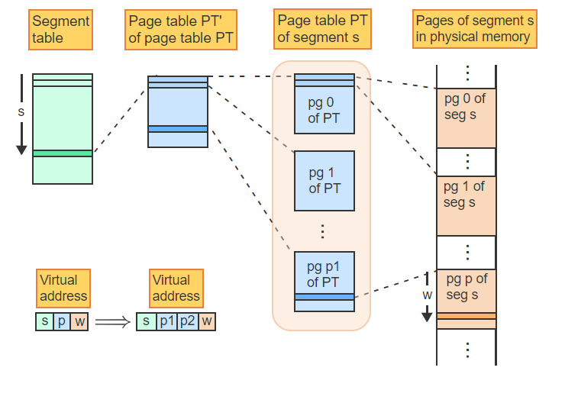
Paged Page Table Address Translation – 4
The page number p is divided into two components, p1 and p2, resulting in a virtual address of the form (s, p1, p2, w)

Slide 25
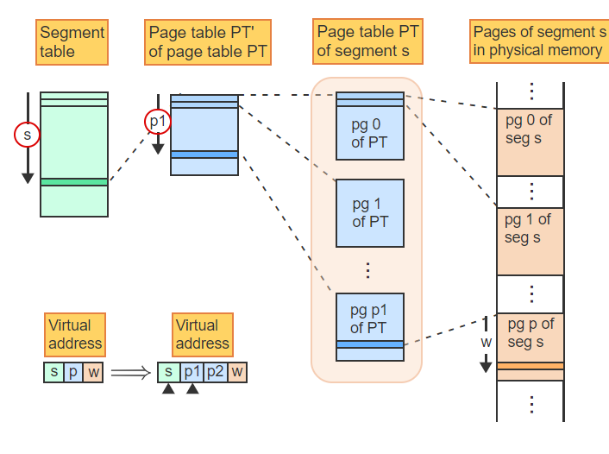
Paged Page Table Address Translation – 5
s selects the segment. p1 selects the entry in the page table PT' of the page table PT that points to page p1 of PT.

Slide 26
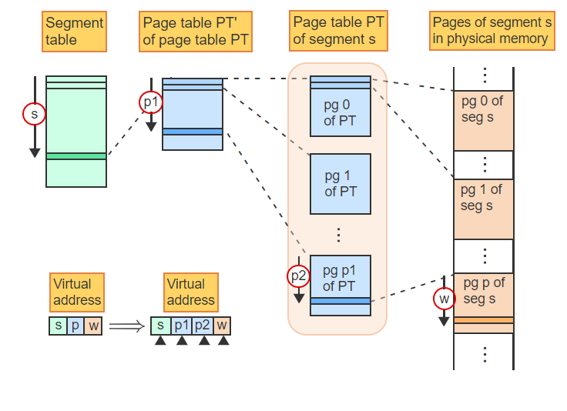
Paged Page Table Address Translation – 6
p2 is an offset into page p1 of PT, which contains the frame number of the page containing the word corresponding to the virtual address (s, p1, p2, w)

Slide 27
Page Replacement
How do we decide which page to replace?
Ideally, we want the least number of page faults (i.e., page not resident).
Page replacement algorithm(s) coming up!
Optimal Page Replacement Algorithm.
FIFO Page Replacement Algorithm.
LRU Page Replacement Algorithm.

Slide 28
Page Replacement → Fixed # of Frames
Memory consists of a fixed number of frames.
One approach to sharing the frames among multiple processes is to let the processes compete with one another.
When a page fault occurs and no free frame is available, the algorithm chooses one of the resident pages for replacement, regardless of which process the page belongs to.
A reference string is the sequence of page numbers referenced by an executing program during a given time interval.
Reference strings are used to compare different page replacement algorithms by counting the number of page faults generated.

Slide 29
Optimal Page Replacement Algorithm
The best page replacement algorithm that results in the least amount of page faults.
In other words: The optimal page replacement algorithm selects the page that will not be referenced for the longest time in the future.
The algorithm is guaranteed to generate the smallest number of page faults for any reference string.
However, the algorithm is unrealizable because the replacement decisions depend on future references, which are unknown at runtime.
But the algorithm provides a useful lower bound on the number of page faults for comparison with other algorithms.

Slide 30
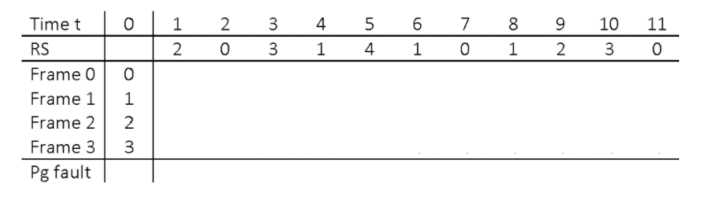
Optimal Replacement Algorithm – 1
The physical memory consists of 4 frames: 0 through 3. Initially, the frames contain the pages 0 through 3. RS is the reference string

Slide 31
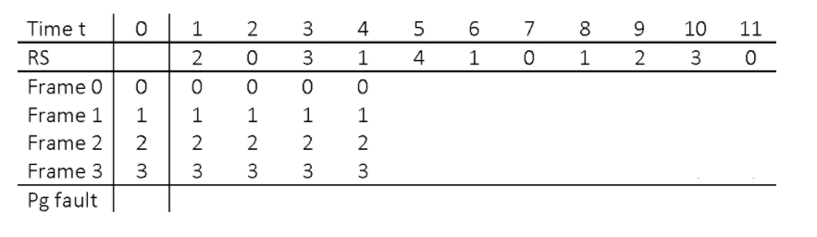
Optimal Replacement Algorithm – 2
Pages 2, 0, 3, and 1 are referenced during the first 4 time steps and are all resident. No page faults occur and the frames remain unchanged

Slide 32
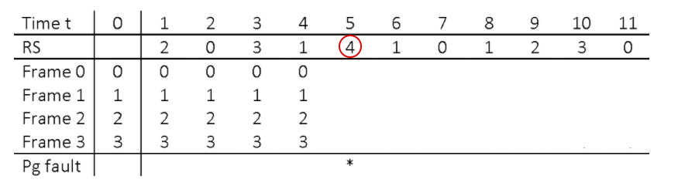
Optimal Replacement Algorithm – 3
At time 5, a non-resident page 4 is referenced, causing a page fault. Page 4 must replace one of the resident pages

Slide 33
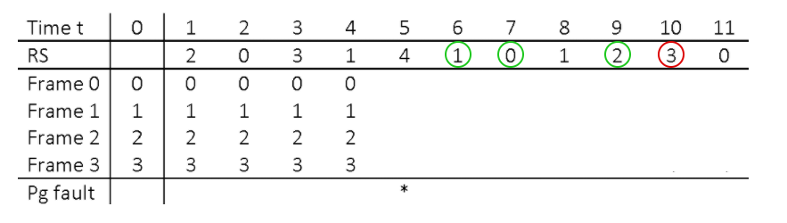
Optimal Replacement Algorithm – 4
The algorithms searches the RS for the resident page that will be referenced in the most distant future. Pages 1, 0, and 2 are all referenced before 3. Thus page 3 is selected

Slide 34
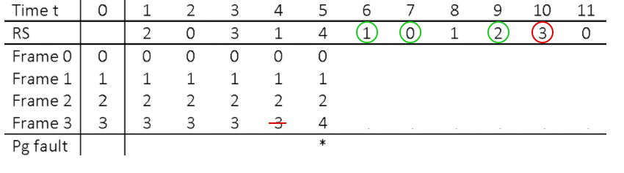
Optimal Replacement Algorithm – 5
The identified page 3 is replaced by page 4

Slide 35
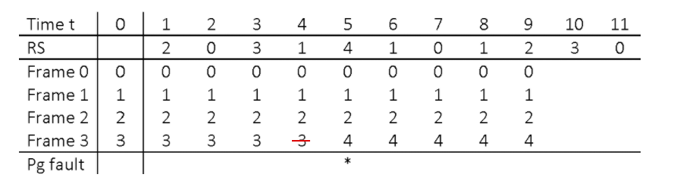
Optimal Replacement Algorithm – 6
The next 4 references to pages 1, 0 and 2 cause no page faults since all three pages are resident

Slide 36
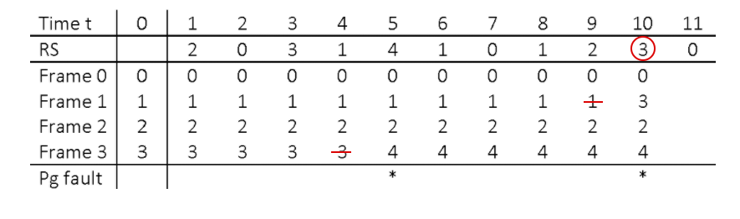
Optimal Replacement Algorithm – 7
The next page fault occurs at time 10 since page 3 has been overwritten previously. Pages 1, 2, and 4 are not referenced again in the future and thus one is chosen for replacement by page 3

Slide 37
FIFO Page Replacement Algorithm
The FIFO page replacement algorithm selects the page that has been resident in memory for the longest time.
The algorithm is easy to implement, requiring only a single pointer to designate the oldest page in memory. When the page is replaced, the pointer is advanced to the next frame modulo n.
The FIFO algorithm takes advantage of the principle of locality.
Except for branch instructions, which constitute only a small percentage of all instructions, execution is sequential.
As execution advances sequentially through the code, the likelihood of referencing a page used in the distant past diminishes with time.
Similarly, many large data structures are processed in sequential order.

Slide 38
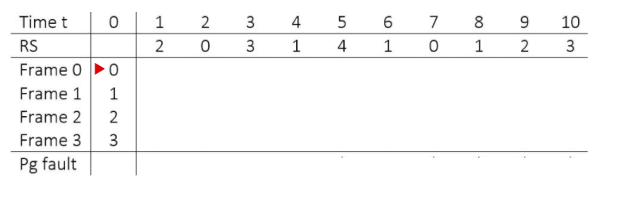
FIFO Page Replacement Algorithm – 1
The physical memory consists of 4 frames 0 through 3. Initially, the frames contain the pages 0 through 3, where 0 is the oldest and 3 is the youngest page

Slide 39
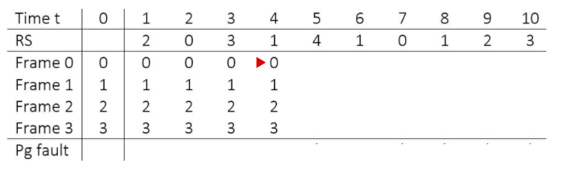
FIFO Page Replacement Algorithm – 2
Pages referenced at times 1 through 4 are all resident and cause no page faults. Page 0 remains the oldest page in memory

Slide 40
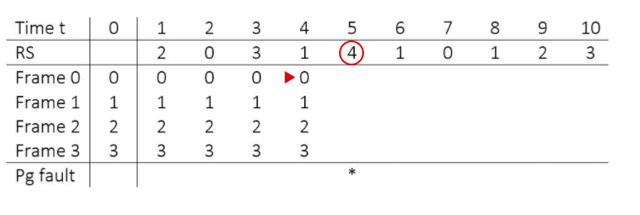
FIFO Page Replacement Algorithm – 3
The reference to page 4 at time 5 causes a page fault

Slide 41
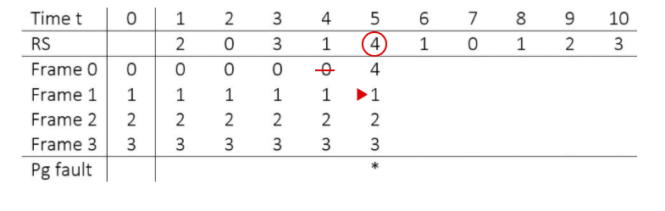
FIFO Page Replacement Algorithm – 4
Page 4 replaces the oldest page 0 and the pointer is advanced to page 1, which is now the oldest page in memory

Slide 42
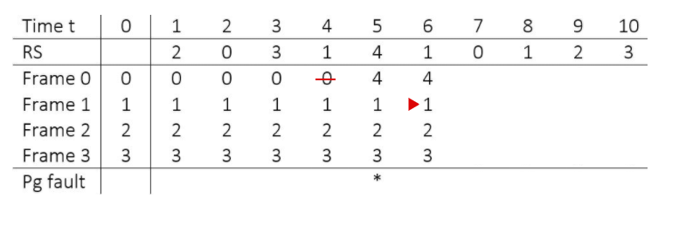
FIFO Page Replacement Algorithm – 5
The reference at time 6 causes no changes

Slide 43
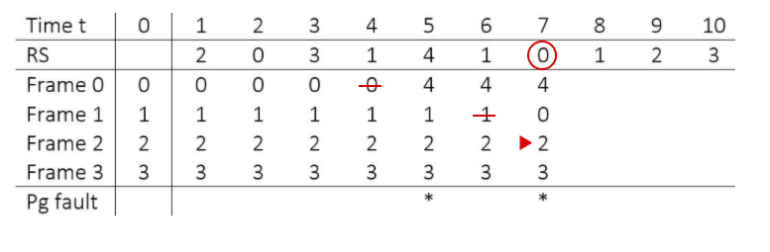
FIFO Page Replacement Algorithm – 6
The just removed page 0 is referenced again at time 7, causing the replacement of the now oldest page 1

Slide 44
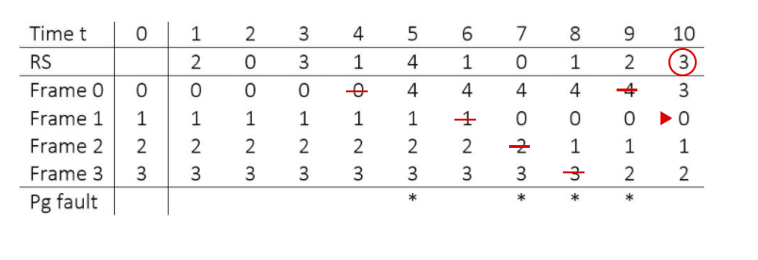
FIFO Page Replacement Algorithm – 7
Similarly, the next 3 references all cause a page fault because each referenced page has just been removed by the previous page fault

Slide 45
LRU Page Replacement Algorithm
LRU or the Least Recently Used Page Replacement Algorithm leverages the principle of reference to a high degree.
Reminder: There are two types of locality
Temporal
Spatial
The main problem with FIFO is that it will replace a page even if it was referenced recently.
Pages can be resident for a long period of time and still be in continuous use.
LRU selects the page that has not been references for the longest period of time.

Slide 46
LRU Page Replacement Algorithm
The implementation requires a queue of length n, where n is the number of memory frames. The queue contains the numbers of all resident pages.
Whenever a resident page p is referenced, p is moved to the end of the queue. Thus the queue is always sorted from most recently used page to least recently used page.
When a non-resident page p is referenced, p is moved to the end of the queue and the least recently referenced page q at the head of the queue is removed. Page p then replaces q in memory.

Slide 47
LRU Page Replacement Algorithm
A queue is an attractive data structure.
Implementing a queue is relatively simple you can use a simple LinkedList and simply set the last element to become the head.

Slide 48
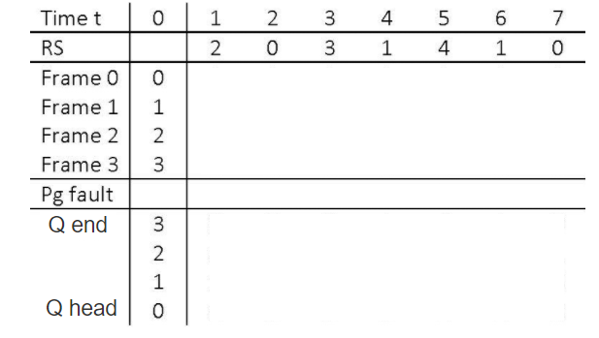
LRU Page Replacement Algorithm – 1
The 4 frames contain pages 0 through 3. The queue shows that 3 is the most recently referenced page and 0 is the least frequently referenced page

Slide 49
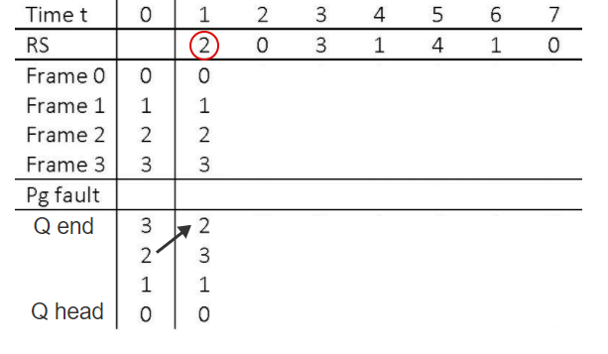
LRU Page Replacement Algorithm – 2
At time 1, page 2 is referenced. The page is resident so no page fault results but the queue is reordered by moving 2 to the head

Slide 50
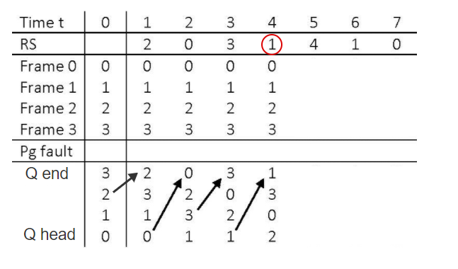
LRU Page Replacement Algorithm – 3
Similarly, no page faults are caused by the next 3 references but the queue is reordered each time

Slide 51
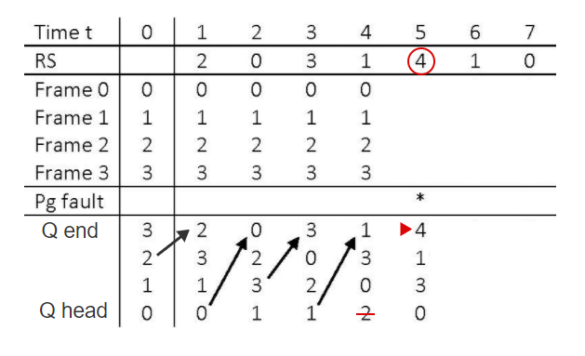
LRU Page Replacement Algorithm – 4
At time 5, page 4 causes a page fault. The page at the end of the list (page 2) is removed from the queue and the new page 4 is inserted at the head

Slide 52
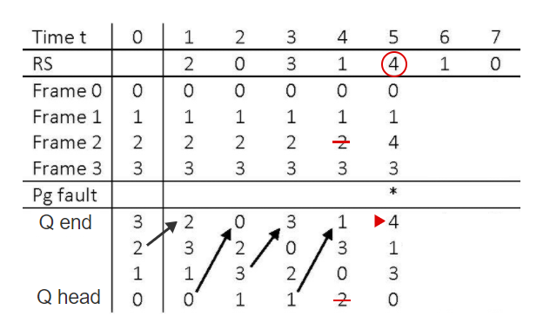
LRU Page Replacement Algorithm – 5
Page 4 then replaces page 2 in memory

Slide 53
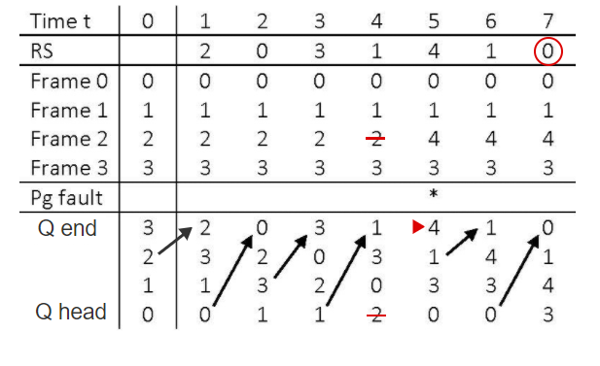
LRU Page Replacement Algorithm – 6
The next 2 references cause no changes to memory but continue reordering the queue

Slide 54
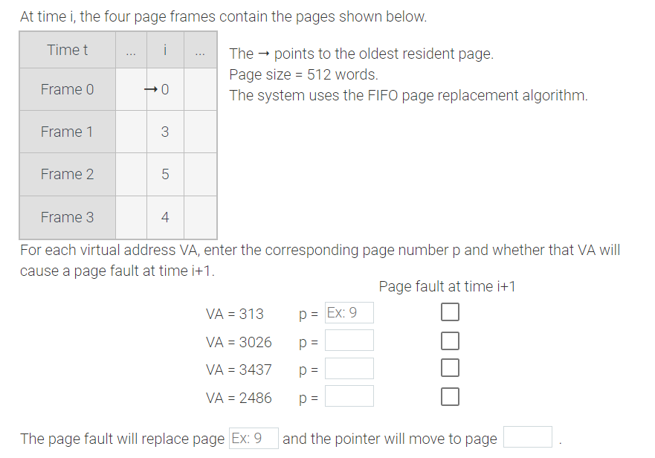
Page Replacement Algos – Exercise

Slide 55
LRU Algorithm Approximations
The LRU requires the queue of pages to be modified at each memory reference, which makes the algorithm too inefficient in practice.
Several algorithms exist that approximate LRU and can be implemented efficiently:
The Aging Page Replacement Algorithm (Covered)
The Second Chance Page Replacement Algorithm (Read)
The Third Chance Page Replacement Algorithm (Read)

Slide 56
Aging Page Replacement Algorithm
A referenced bit (r-bit) is a bit associated with a page and is set automatically by the hardware whenever the page is referenced by any instruction.
An aging register is associated with a page and is shifted periodically to the right by 1 bit.
Unless the most significant bit is set to 1, the page is aging in the sense that the associated register value is steadily decreasing.
The aging page replacement algorithm does not maintain pages sorted in the exact LRU order, but groups together pages referenced during a period of d consecutive references.
Each period is represented by 1 bit in a periodically shifting aging register.

Slide 57
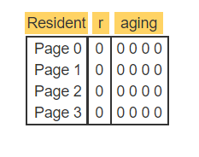
Aging Page Replacement Algorithm – 1
Initially, pages 0 - 3 are resident. The r-bits and the aging registers all contain zeros

Slide 58
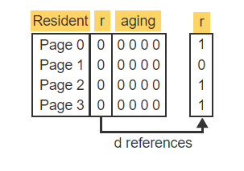
Aging Page Replacement Algorithm – 2
After d references, the r-bits show that pages 0, 2, and 3 have been accessed at least once during the past d references

Slide 59
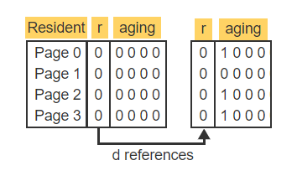
Aging Page Replacement Algorithm – 3
All aging registers are shifted to the right. The r-bits are shifted into the most significant positions of the aging registers and then reset to 0

Slide 60
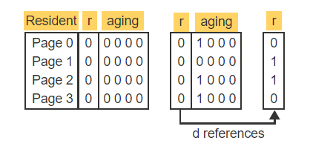
Aging Page Replacement Algorithm – 4
During the next d references, pages 1 and 2 were accessed at least once and so the corresponding r-bits are 1

Slide 61
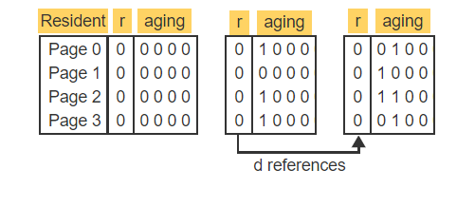
Aging Page Replacement Algorithm – 5
The aging registers are again shifted to the right. The r-bits are shifted into the most significant register positions and then reset to 0

Slide 62
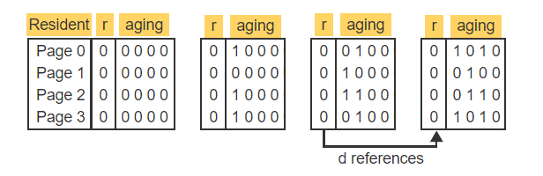
Aging Page Replacement Algorithm – 6
During the next d references, pages 0 and 3 are accessed and the same steps of shifting and resetting the r-bits are repeated

Slide 63
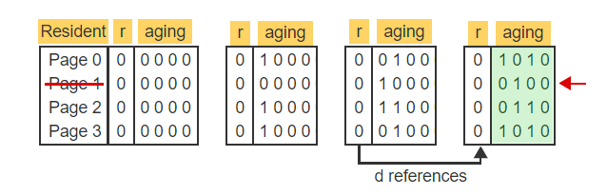
Aging Page Replacement Algorithm – 7
If a page fault occurs, then all registers are compared and the page with the smallest value is selected. Page 1 is replaced with the faulting page

Slide 64
Aging Page Replacement Algorithm
You can mess around (optimize) d (references) to make the algorithm more efficient depending on the system.
Modifying the queue of pages periodically based on d (references) fixes part of the problem with the LRU page replacement algorithm (the queue of pages to be modified at each memory).

Slide 65
Summary
What is Virtual Memory?
Is the virtual memory address space typically larger or smaller than the physical address space?
Why is the LRU page replacement algorithm inefficient in practice.
What alternatives exist to alleviate this problem?
Why is the principle of locality of reference very crucial? What are machines designed to avoid?

